Slide 1
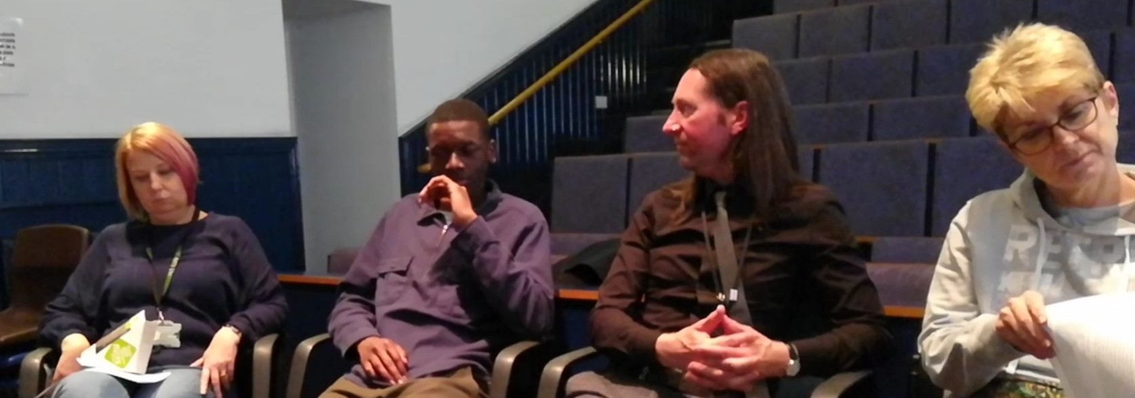
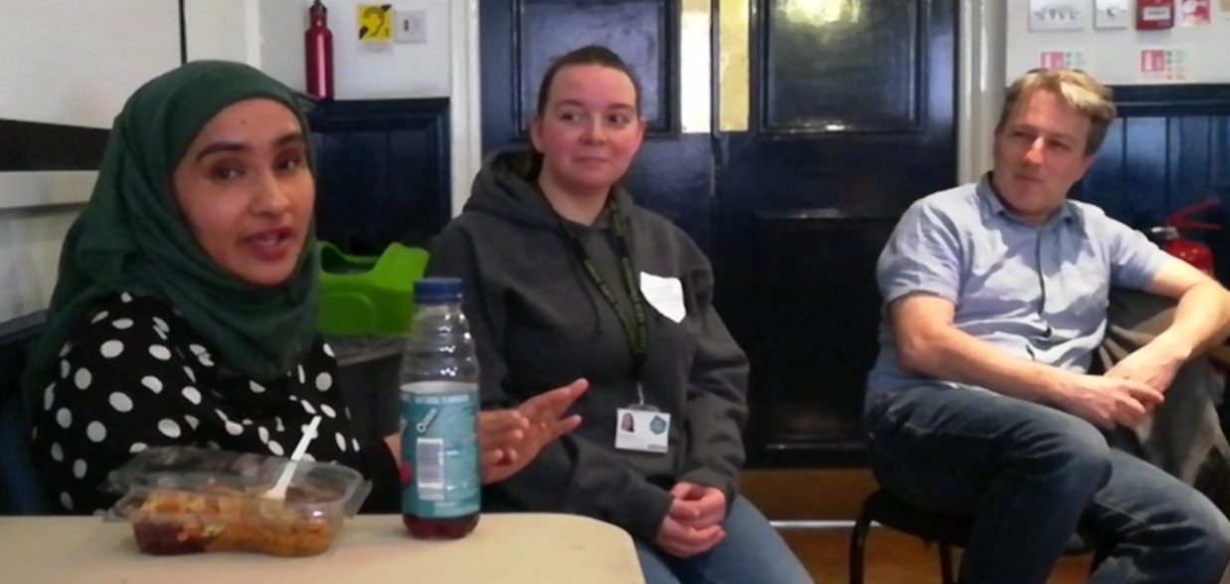
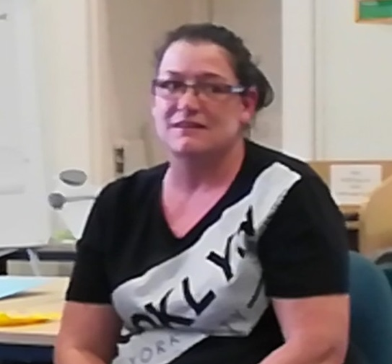
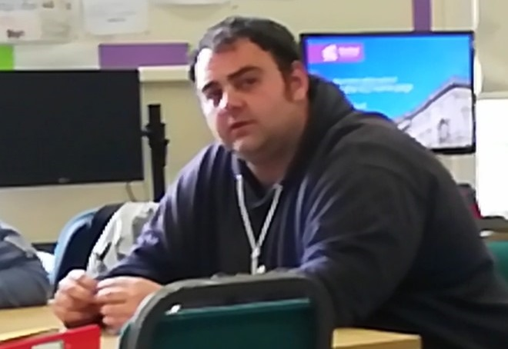
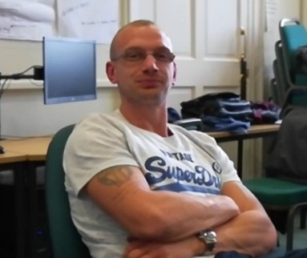
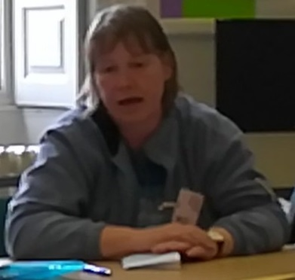
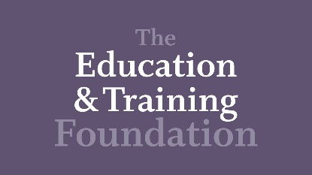
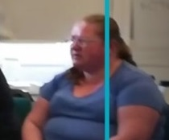
ETF Conference 1st July 2019, Mary Ward House, London.
Deflecting risk, increasing citizenship: JPD Debate Club at two FE colleges, exploring the potential impact of critical thinking strategies.
Debate Club Participants at two Northern FE Colleges.
Frances-Ann Norton; Senior Lecturer and Course Coordinator MA in Creative Practice, Leeds Arts University: frances.norton@leeds-art.ac.uk: Twitter: https://twitter.com/francesann800 : PhD Blog: https://talkingaboutartphd.blogspot.com/ ; Paul Gibson, Lecturer at Northern College: pgibson@northern.ac.uk
Notes:
Frances: Hello my Name is Frances Norton I am course leader of the MA in creative Practice at Leeds Arts University,
Paul: hello my Name is Paul Gibson I am course leader and learning manager at Northern College

Slide 2
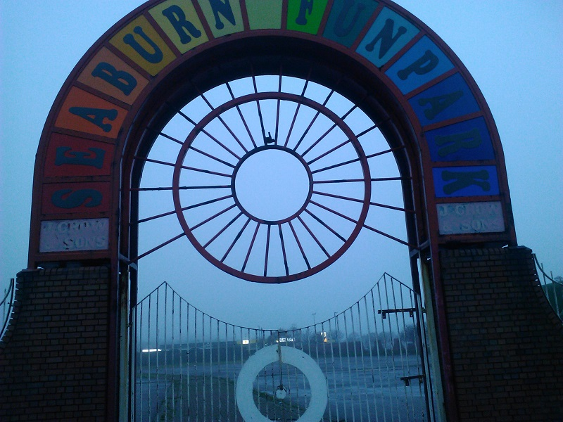
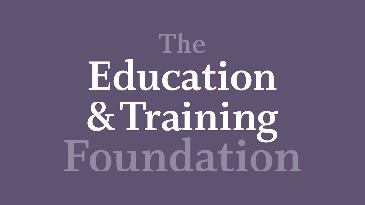
With thanks to ETF, SUNCETT, and Leeds Arts University for funding this research.
Notes:
Frances : With thanks to ETF, Leeds Arts University and Northern College for funding this research.

Slide 3
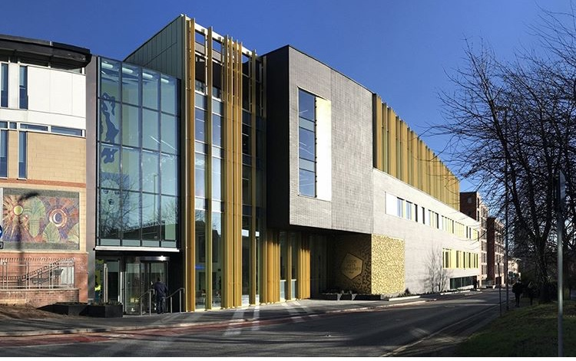
Introduction
The Institutes
Notes:
Frances: part of the research is conducted at Gimmerton College of Art. There are 2600 students across FE and HE. The institute offers a wide range of arts and crafts disciplines from printmaking to digital animation. All these pathways are designed to industry standards. I teach level two diploma to level seven masters.
Paul: this is a joint practice development Project with Pitown College in the North of England, these are anonymised institution and participant names. There are 4,000 students at Pitown College who are mainly returning to education after several years absence, often due to prison, drug/alcohol dependency, survivors of modern slavery and human trafficking.

Slide 4
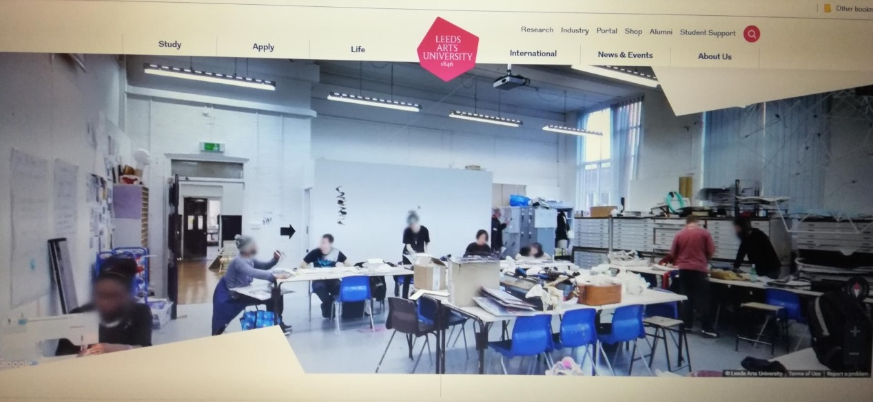
Context and problem
Risks students face
Notes:
Frances: Vocational FE students appeared to be resistant to the written element of the course work, while being enthusiastic about practical sessions. Adult learners at level 2 and 3 often have low literacy levels, low self-confidence and a narrow view of the world. I want to understand how to develop critical thinking skills for FE student to increase confidence, a sense of belonging and citizenship and broaden horizons and deflect risk. To that end I devised a number of CT interventions and piloted them at Gimmerton and Pitown.
Brown (1998: 1) believes there is a thinking skills deficit.
The Canadian Ministry of Education states that all students will need to develop a flexibility and a versatility undreamed of by previous generations (Shaheen, 2007).
Foresight review into Lifelong learning 2016 states, “Better skills enable freedom of opportunity, provide people with the tools to adapt to a changing world and promote social mobility, inclusion and wellbeing.”
Kennedy (1997) outlines the need for adult learning to reach into the community, and education to work for social cohesion as well as encouraging social mobility.
Paul: Risk comes in many forms.
Johnstone (2018) states that ‘75 % of mental health problems are established by the age of 25’.
And the Office of National Statistics, (2018) states, 19 % of the UK student population displays common mental health disorders.
There are 51.1% of the current FR cohort with common mental health issues at Gimmerton
The potential effect of this are:- suicide, self-harm and risk taking behaviours. radicalisation, idealism can lead to extremism, violence and illegal actions in the name of that group.
Vulnerable students are at risk of falling prey to these effects

Slide 5
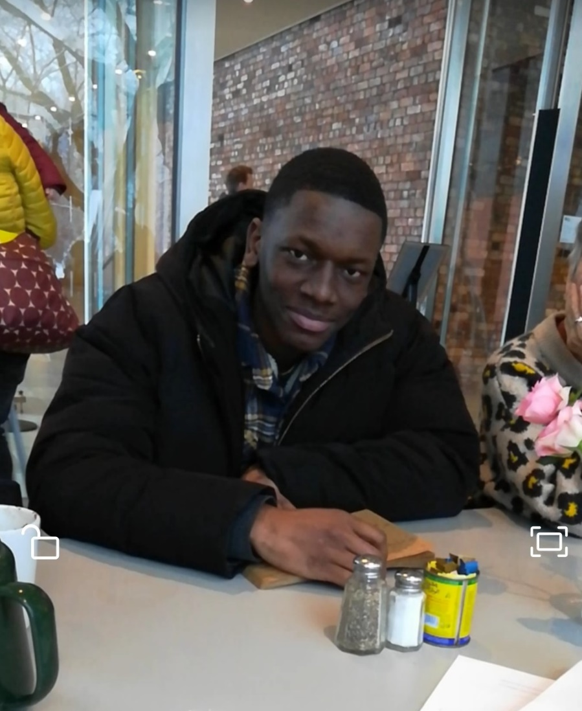
Relevant Literature
Notes:
‘practitioner in the sector’ authors Broadhead and Gregson (2018) and Coalter (2008);
Lipman 2003 and , Brown 1998 thinking in education,
Vygotsky, linguistics
Freire 1968, education for all.
Biesta. (2010) philosophy of education .
Fielding 1995 community of practice.
Gregory … narrative inquiry.
Practice led research Sennett 2008

Slide 6
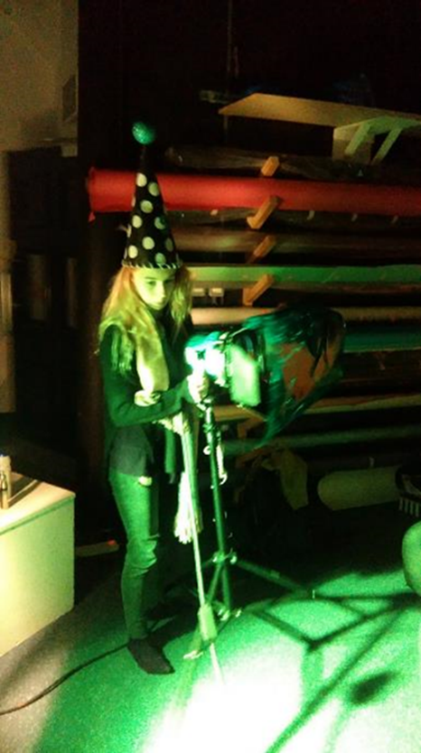
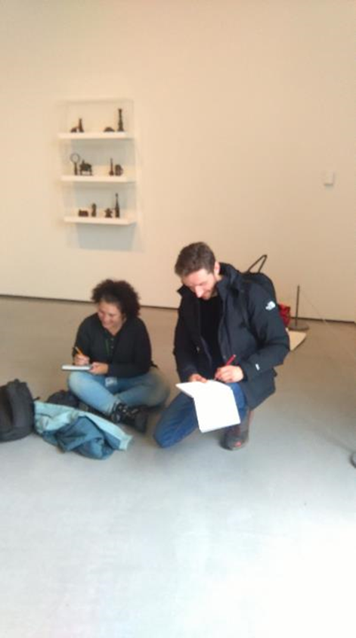
Methodology and method
Notes:
Frances:
The ontological underpinning of this thesis is heuristic in that it explores the subjective experience of developing critical thinking with and within a group of students.
The epistemology is qualitative framed by an interpretivist paradigm. That is, studying social phenomena, as education itself is socio-cultural.
This paper works with 222 self-selecting participants.
The research design is that of a small-scale, pedagogic arts and social science study.
Research approach is Practitioner Research, community of inquiry and narrative inquiry.
As a qualitative study the thesis does not have variables or control groups.
As an insider and an outsider I am part of the interventions, both participant and researcher
Interventions have included Diary projects, book club, poetry writing group, and debate club,
This paper focuses on the debate club. We met for 5 weeks in 2 locations
Paul: Ethics.
we work with BERA (2018) guidelines, Sunderland, LAU and NC ethics approval.
The study is representational and avoids deceptions in dealings with participants who have an information sheet and sign a participant agreement form. They are free to leave the study at any point.
The paper aims to protect and anonymise participants and institutions. Confidentiality of identities and institutions is kept safe in encrypted files and locked draws.
This paper collects data from Further Education participants.

Slide 7
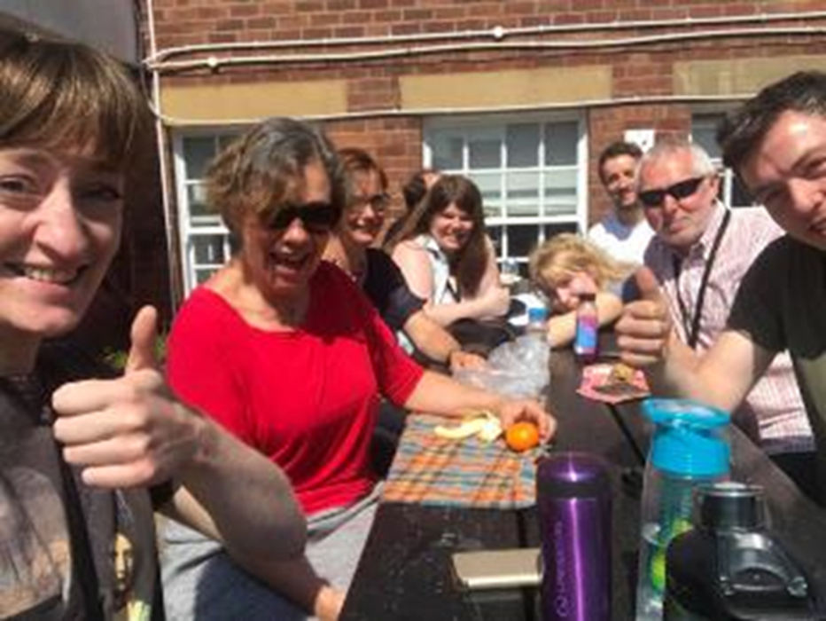
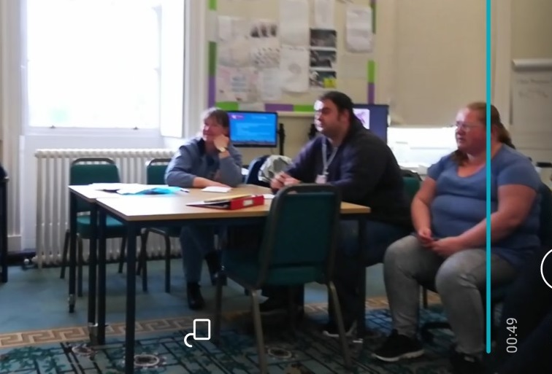
Data
The Participants
Notes:
Frances:
The participants from Gimmerton College of art are a constant, the same students came every week. They are from a mixed socio-economic background. Participants are vulnerable adults and some from professional backgrounds. A number have disclosed and undisclosed mental health issues and some are homeless (couch surfing).
The first category of participant is a young adult school-leaver. Participants such as Anthony, a croupier who takes bets seven nights a week in a local casino. He also supports a young family but wants to go to university. Coalter (2008) considers that social capital and the small world of a FE classroom relates to the larger networks of the workplace, community, and HE.
The second category of student is older, well qualified, perhaps disenchanted or ‘burned out’ professional. As Maia, a GP, and told me, ‘Needy patients have broken me.’ She has come to art school to escape the drifts of paperwork.
Paul: The participants from Pitown are more disparate, often different volunteers each week, they don't know each other well, there is not the trust or community yet. Participants are from post-industrial high unemployment ex mining communities. Some recovering from addictions and volunteers self-refer to college from a number of sources, from community learning outreach which may be leaflets in GP surgeries, libraries, and supermarkets. Some are referred by support workers of trafficked people and survivors of slavery.

Slide 8
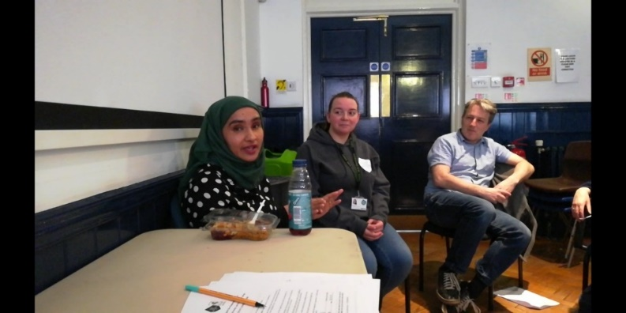
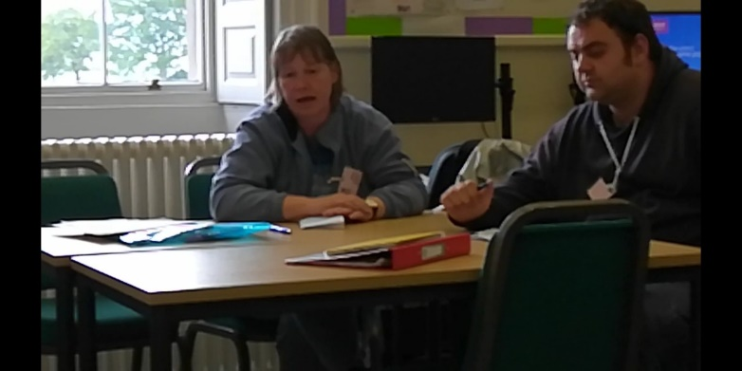
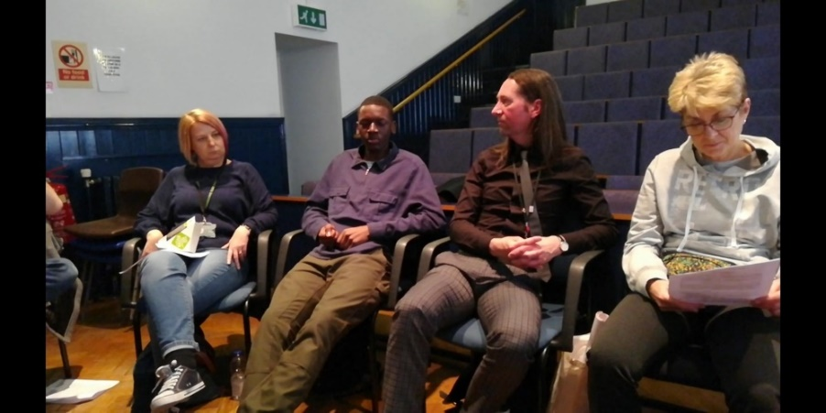
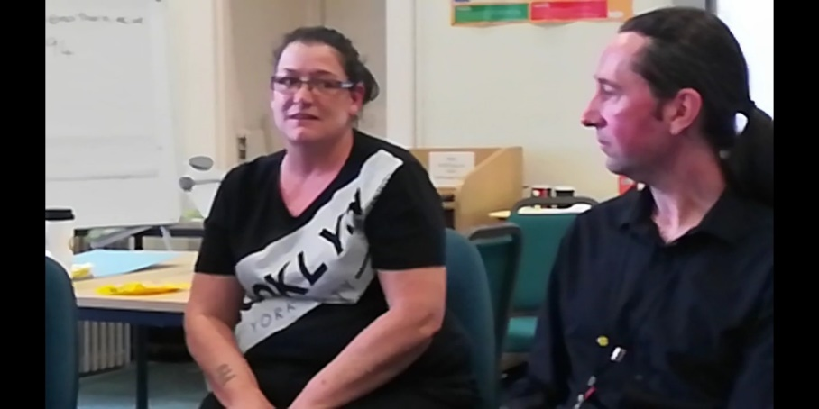
Analysis The Debate Club
Gimmerton College of Art
Pitown College
Notes:
Frances: The two most accepted themes from debate club are that critical thinking is a skill, a practice, a muscle that needs developing and that by using questioning critical thinking can be developed as a tool to increase reflection. “I think that sort of pushing someone through teaching them in that Socratic way is what really, really makes the deep critical thinker” Janus. There was a lot of talk about giving oneself permission to have an opinion.
These are cultural and class barriers to overcome in debate club. Some of these obstacles are socially constructed and some are self-imposed based on the individual’s social locators. “It’s like the only way to know if there is a line, is to cross it.” Skerion.
Paul: Creating a safe space for debate, a non-judgemental arena for ideas and points of view is important to participants. What came out strongly among the debate club is the theme of a social conscience. The idea of self-restraint, having a moral compass, a kind of internalised citizenship, a set of precepts by which one is deemed decent, kind, caring, considerate, creative, not just individually focused but aware of ones contribution to the community as a whole.

Slide 9
Tentative Findings
Critical thinking through
intergenerational discussion
Notes:
Frances: themes of students enjoying group bonding, social cohesion; addressing issues of mental health wellbeing, and mindfulness, also development of English language skills for students from other countries. In the debate club, a facing of risk through being open to new ideas and thoughts as well as developing speaking and listening skills, and going beyond our cultural locators, moving towards social mobility and increased cultural capital.
Paul: These interventions offer participants an intergenerational, cross cultural space to tell their story, which could enable social cohesion in college and in wider citizenship areas. The practice of critical thinking allows more use of wise judgements in reaction to risk which is ever present in all our lives from many quarters.

Slide 10
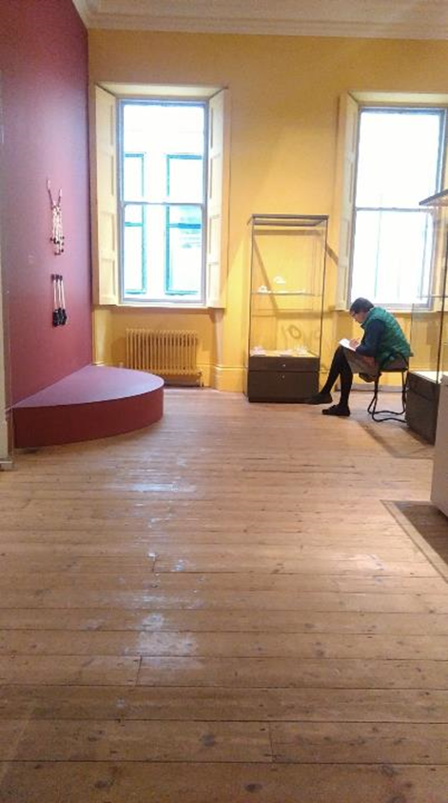
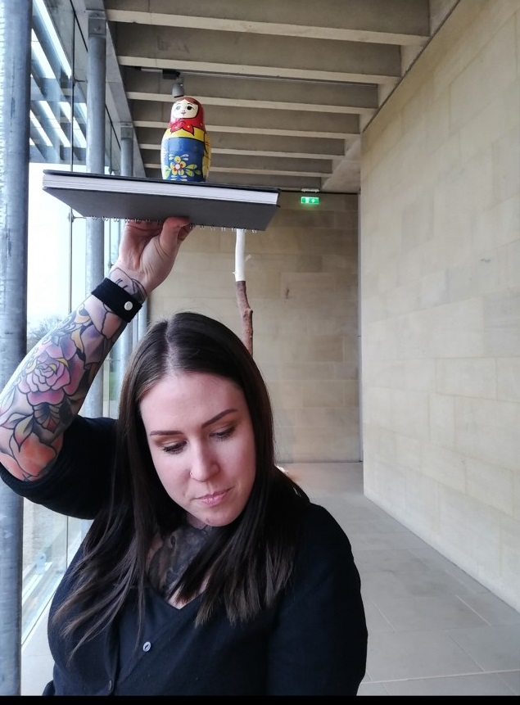
Recommendations
Notes:
Frances:
The central theme of the presentation asks, can critical thinking skills aid in deflecting concepts of fear and risk and promote concepts of citizenship and community of inquiry?
This research may need a ‘health warning’ in this current antagonistic political climate towards FE.
A Department of Education report states, “There is a lack of evidence on how current practices operate to improve quality and improve learners’ outcomes.” (Owen 2018) this presentation hope to address this statement.
My recommendations of social intervention via soft skills could be viewed as ‘un-scientific’ due to the use of social science, interpretivist, qualitative methodologies.
Interventions analysed interpretively in a small scale ethnography are not the same as hard statistics.
The challenge for us is to seek to inject CT creativity into the curriculum.
Paul:
As educators and policy makers we could expand our ideas of where education can happen, especially for adults. The online space is flexible and portable. Learning in informal learning spaces such as community centres, pubs, coffee shops or gallery space takes education to where adults are.
This can only happen through collaboration of agencies and Joint Practice Development.
Reflecting lifelong learning and widening participations policy into the curriculum, in order to promote citizenship and community of inquiry and deflect risk.
As educators and policy makers we need to value our students and their stories, see them as whole people.
Reflect back to government and policy makers the findings of research, that treating students as whole people involves caring for educational and mental health wellbeing.
This could involves a whole community co-operation, from colleges, NHS, community workers, local business and industry, all working together to enact lifelong learning, develop community wide connection so risk is averted in an epistemological way. Using critical thinking skills to connect people, and fuse horizons.

Slide 11
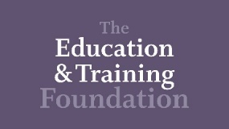
Reference
Department of Education, DfE Kantar Public and Learning and Work Institute. (2018) Decisions of adult learners, Available at: https://assets.publishing.service.gov.uk/government/uploads/system/uploads/attachment_data/file/742108/DfE_Decisions_of_adult_learners.pdf (Accessed 10 February 2019).
Education World Forum. (2018) 2019 themes. Available at: https://www.theewf.org/theme (accessed 7 October 2018).
Foresight Review into the Future of Skills and Lifelong Learning, (2016) available at: https://www.gov.uk/government/collections/future-of-skills-and-lifelong-learning. (Accessed 10 February 2019).
Kennedy, H. (1997) Learning Works. Coventry: Further Education Funding Council. Available at: http://www.educationengland.org.uk/documents/kennedy1997/kennedy-report.html. (Accessed 19 April 2019).
Longfield, A. The Children’s Commissioner for England (2017) New initiative to help children identify fake news welcome addition to on-going digital resilience debate. Available at: https://www.childrenscommissioner.gov.uk/2017/12/06/new-initiative-to-help-children-identify-fake-news-welcome-addition-to-on-going-digital-resilience-debate/ (Accessed 1 October 2018).
Office of National Statistics, (2018), ‘Estimating Suicide Among Higher Education Students, England and Wales’, available at: https://www.ons.gov.uk/releases/estimatingsuicideamonghighereducationstudentsenglandandwales. (Accessed on 25 April 2019).
Ofsted (2010) Learning: creative approaches that raise standards, 15 Jan 2010 Ofsted Ref: 080266.
Available at: https://webarchive.nationalarchives.gov.uk/20141116012722/http://www.ofsted.gov.uk/node/2405. (Accessed 26 November 2018).
Welsh Assembly Government. (2008) Department for Children, Education, Lifelong Learning and Skills. Personal and social education framework for 7 to 19-year-olds in Wales. (A-EAC-02-01-030/KE). Cardiff: Welsh Assembly Government. Available at:
file:///C:/Users/staff/Documents/Documents/MPhil%20suncett%20LSIS%202017%202018/books%20and%20notes%20on%20books/130425-personal-and-social-education-framework-en.pdf (Accessed 8 October 2018).

Slide 12
Thank you
Email: francesnorton@hotmail.com
Email: pgibson@northern.ac.uk
Twitter: https://twitter.com/NCcomlearn
Twitter: https://twitter.com/francesann800
PhD Blog: https://talkingaboutartphd.blogspot.com/
Pinterest: https://www.pinterest.co.uk/francesannnn/talking-about-art

